Slide 1
Interstellar: Searching Recurrent Architecture for Knowledge Graph Embedding
Yongqi Zhang, Quanming Yao, Lei Chen
Presenter: Zhanke Zhou
^{zhankezhou@hust.edu.cn}
^{2021. 04. 01}
Paper: https://neurips.cc/virtual/2020/public/poster_722caafb4825ef5d8670710fa29087cf.html
Code: https://github.com/AutoML-4Paradigm/Interstellar

Slide 2
Outline
Background
Interstellar
Motivation
Method
Experiments
Key takeaways and research directions

Slide 3
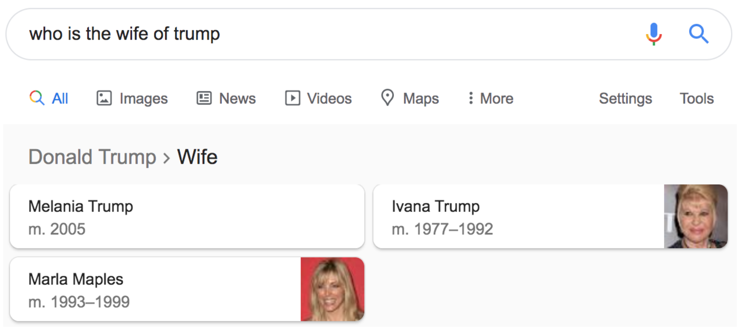
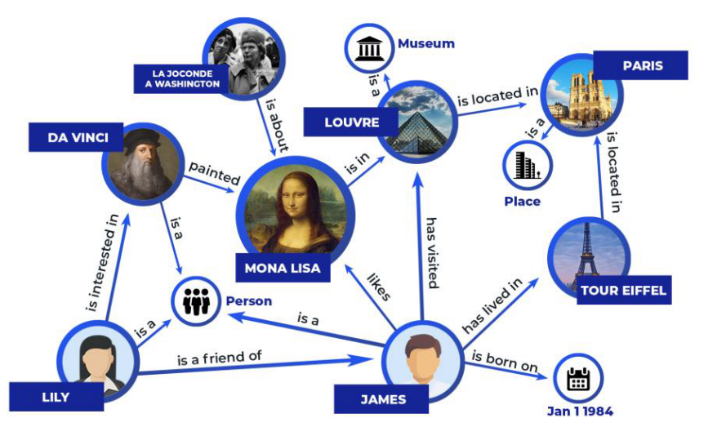
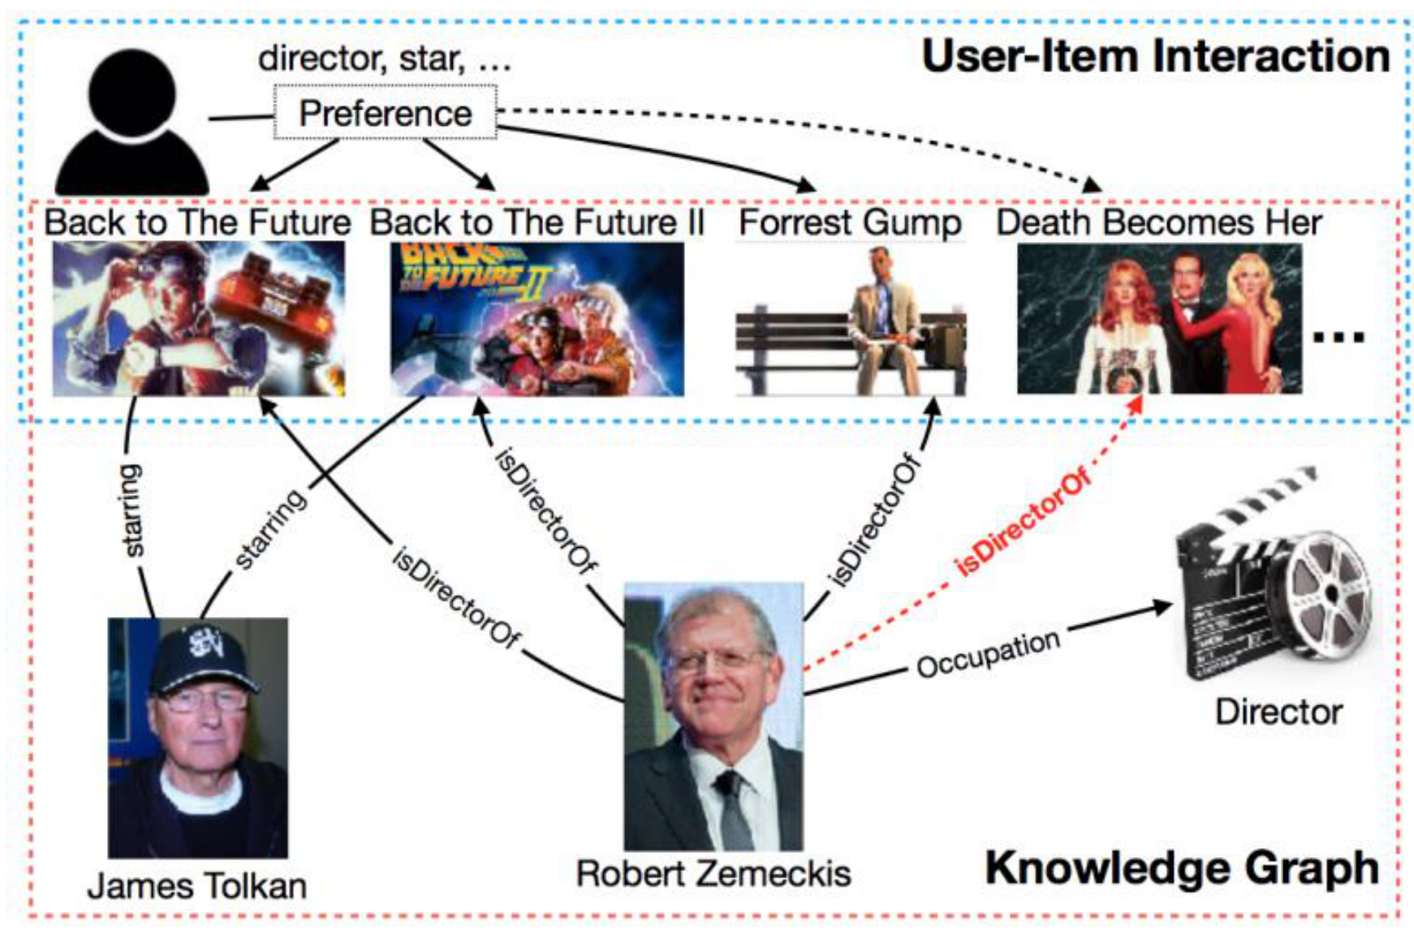
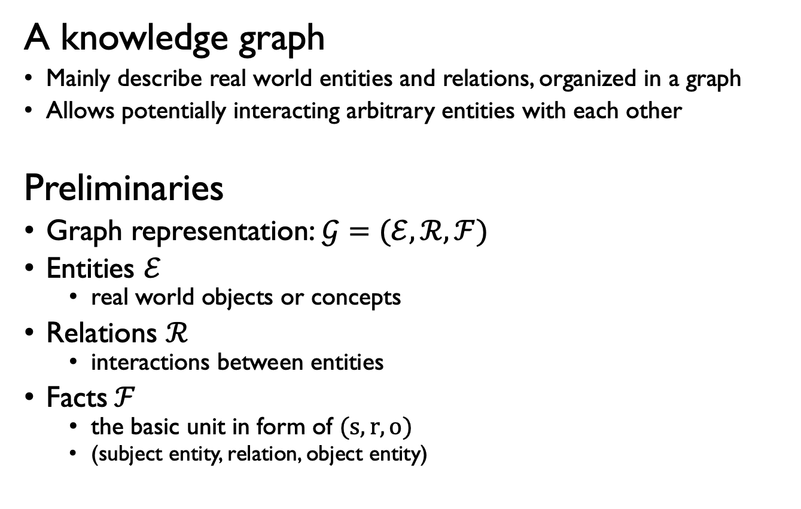
Background – Knowledge Graph (KG)
A knowledge graph
Mainly describe real world entities and relations, organized in a graph
Allows potentially interacting arbitrary entities with each other
Preliminaries
Graph representation:$𝒢=(ℰ, ℛ, ℱ)$
Entities $ℰ$
real world objects or concepts
Relations $ℛ$
interactions between entities
Facts$ℱ$
the basic unit in form of $(s,r,o)$
(subject entity, relation, object entity)
Applications
KGQA:
Recommendation:

Slide 4
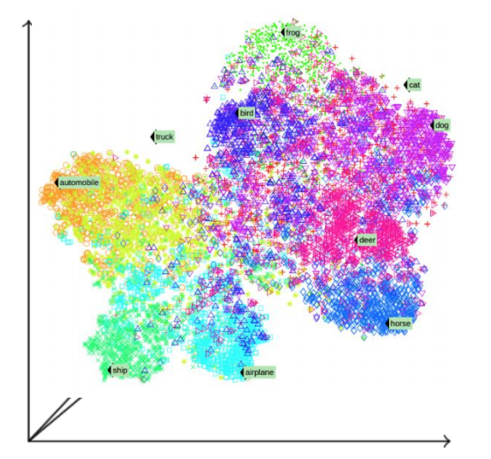
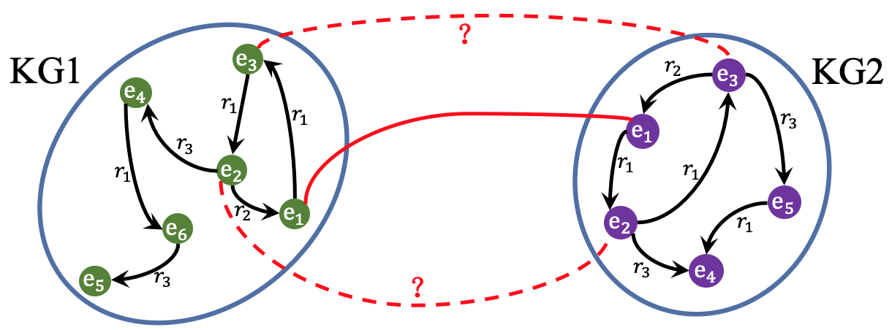
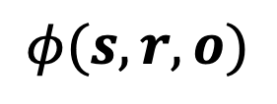
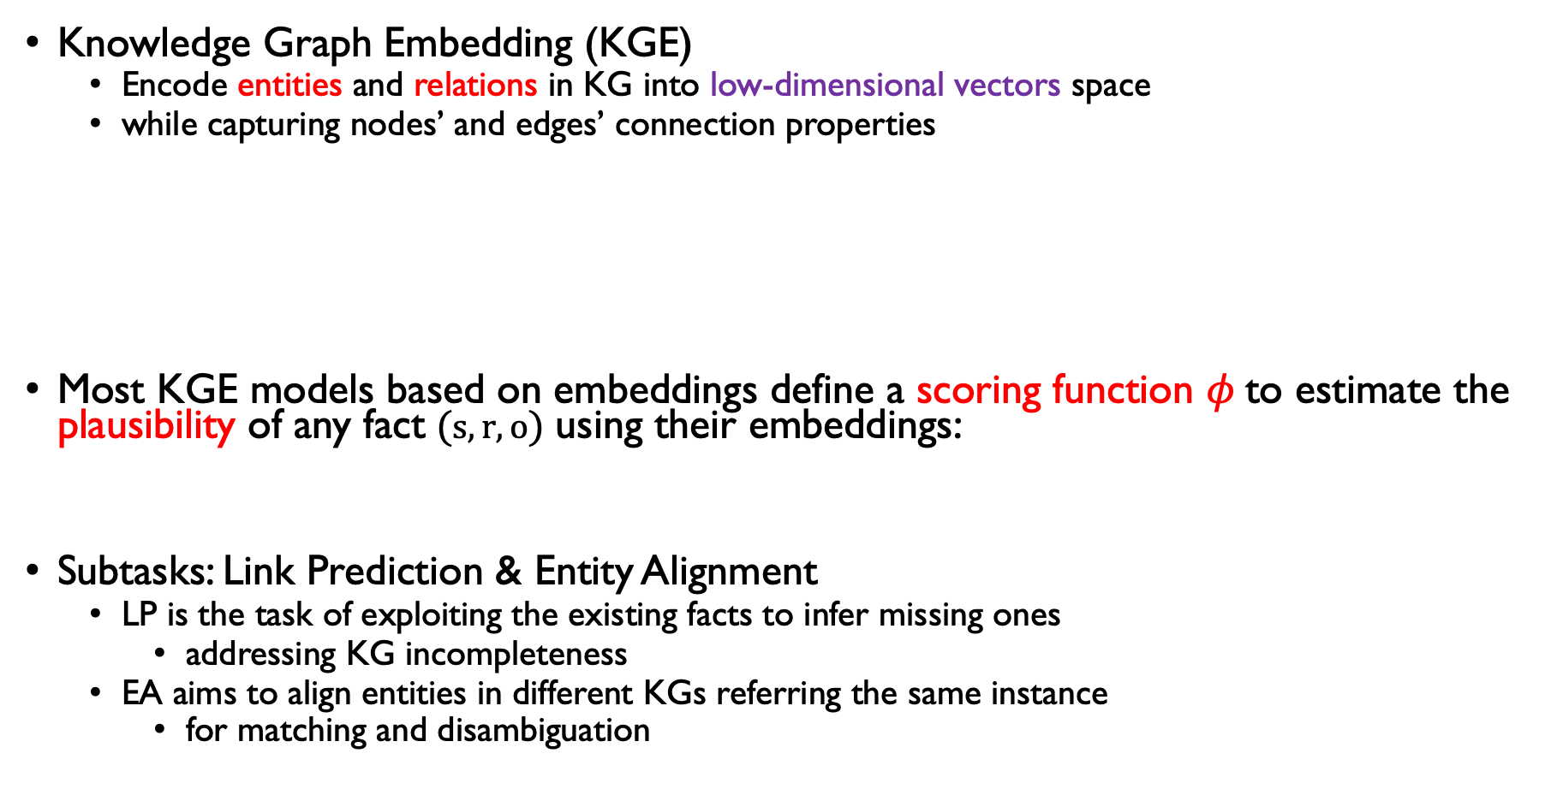
Background – Knowledge Graph Embedding (KGE)
Knowledge Graph Embedding (KGE)
Encode entities and relations in KG into low-dimensional vectors space
while capturing nodes’ and edges’ connection properties
Most KGE models based on embeddings define a scoring function $φ$to estimate the plausibility of any fact $(s,r,o)$ using their embeddings:
Subtasks: Link Prediction & Entity Alignment
LP is the task of exploiting the existing facts to infer missing ones
addressing KG incompleteness
EA ﻿aims to align entities in different KGs referring the same instance
for matching and disambiguation
vectorize
entities & relations
$$φ(s,r,o)$$

Slide 5
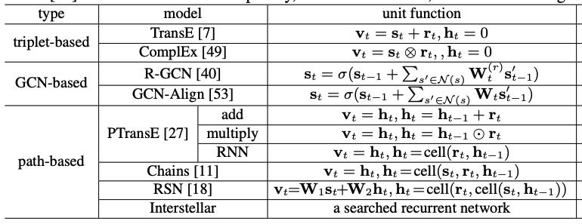
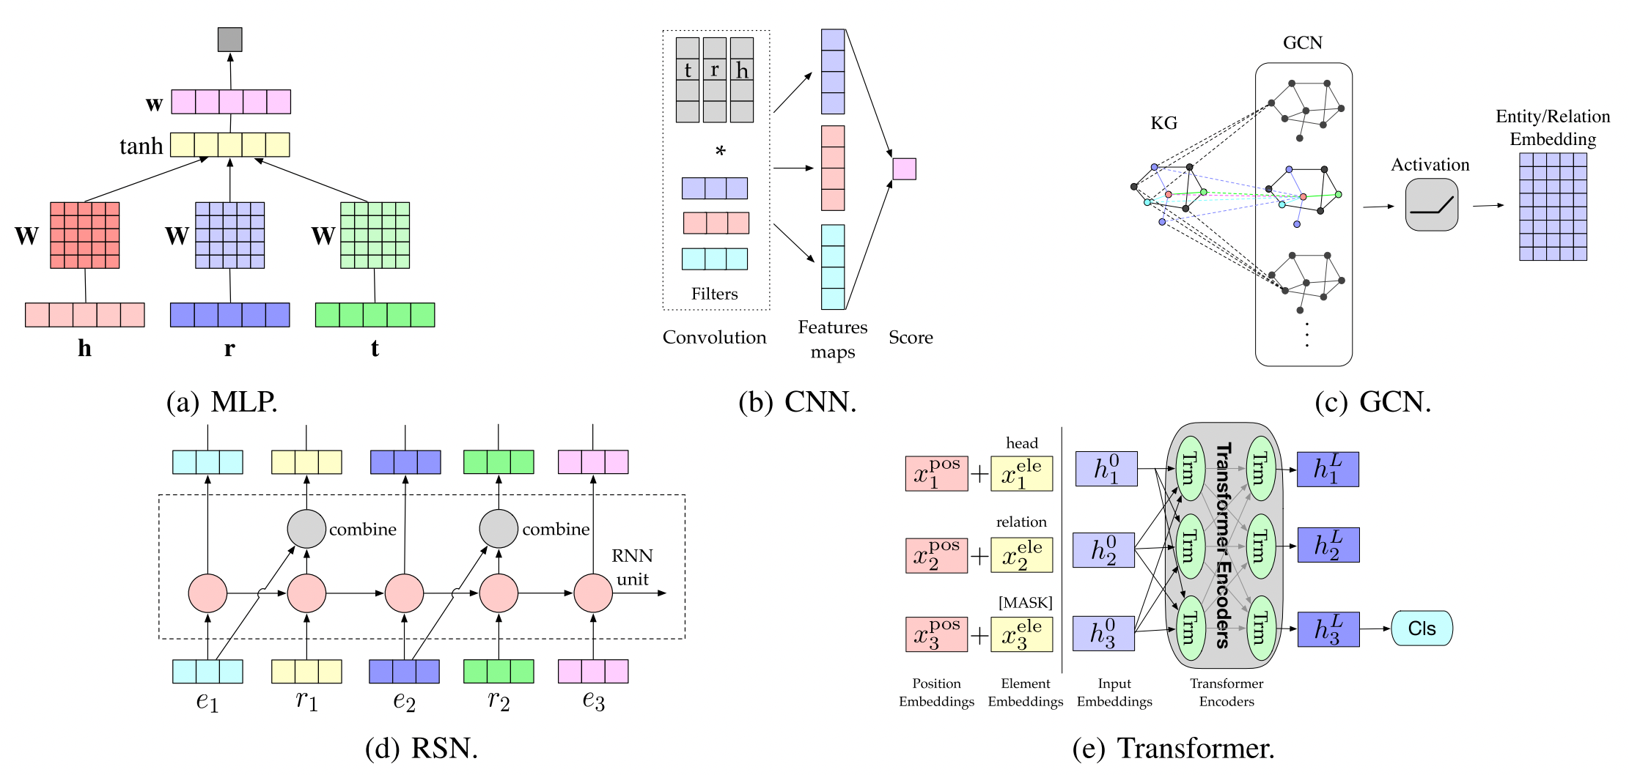
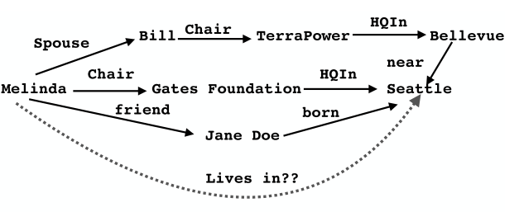
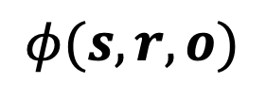
Background – Existing methods
$$φ(s,r,o)$$

Slide 6
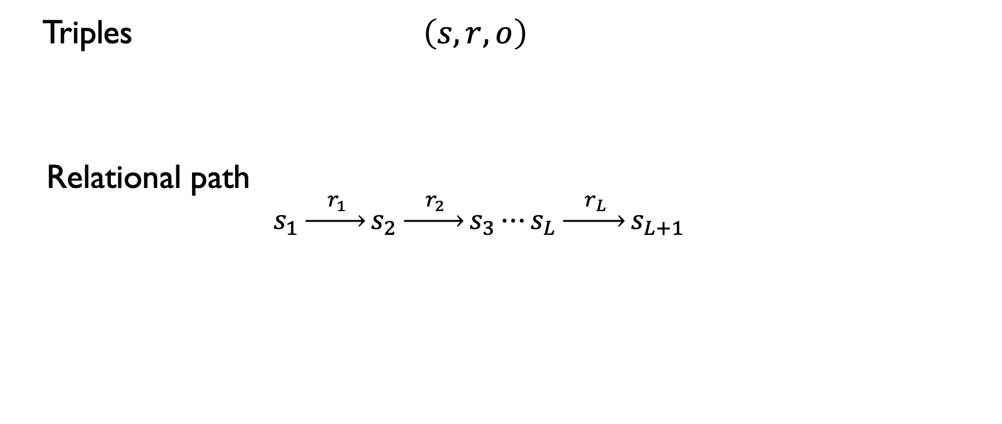
Background – Existing methods
Triples $\left(s,r,o\right)$
Relational path
$$s_{1}\underset{→}{{ r}_{1} }s_{2}\underset{→}{{ r}_{2} }s_{3}⋯s_{L}\underset{→}{{ r}_{L} }s_{L+1}$$
consecutively connected
short-term information inside triplets.
composition of relations.
long-term information across triplets.
Relational path is an important and effective data structure that
can capture the dependency among a sequence of triplets
can preserve both short-term and long-term information in KG

Slide 7
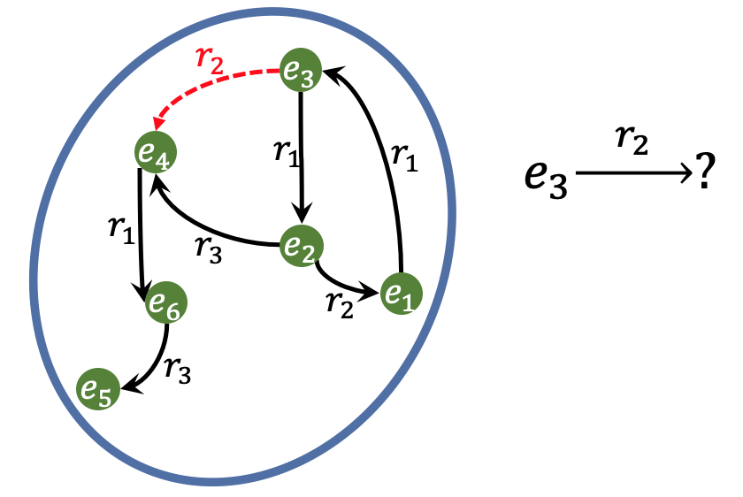
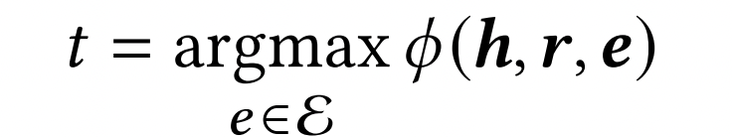
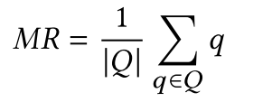
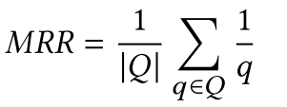
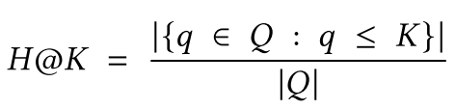
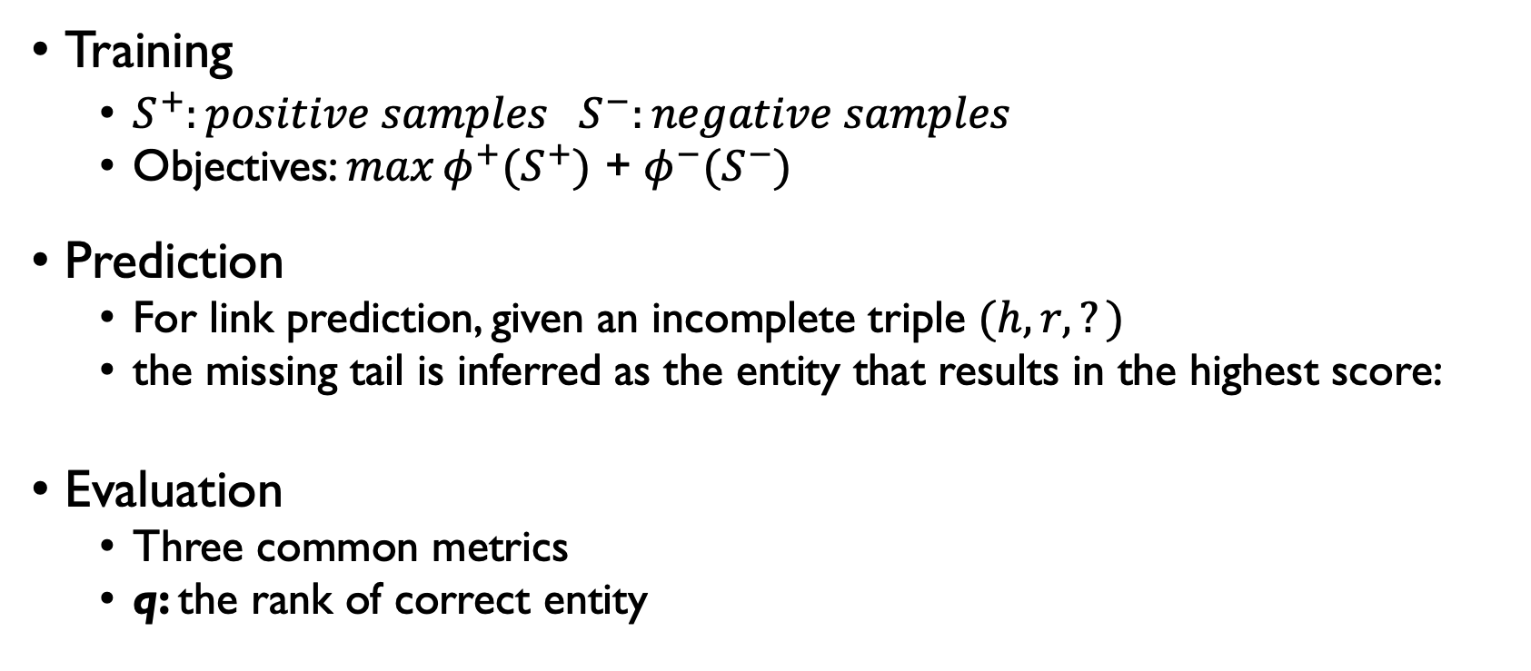
Background – Knowledge Graph Embedding (KGE)
Training
$S^{+}:positive samples S^{−}:negative samples$
Objectives: $\max{φ^{+}(S^{+}) }$+ $φ^{−}(S^{−})$
Prediction
For link prediction, given an incomplete triple $(h, r,?)$
the missing tail is inferred as the entity that results in the highest score:
Evaluation
Three common metrics
q: the rank of correct entity

Slide 8
Background – Knowledge Graph Embedding (KGE)
Main Challenge: How to preserve important information in the embeddings?
Semantical / Topological information
vectorize
entities & relations

Slide 9
Outline
Background
Interstellar
Motivation
Method
Experiments
Key takeaways and research directions

Slide 10
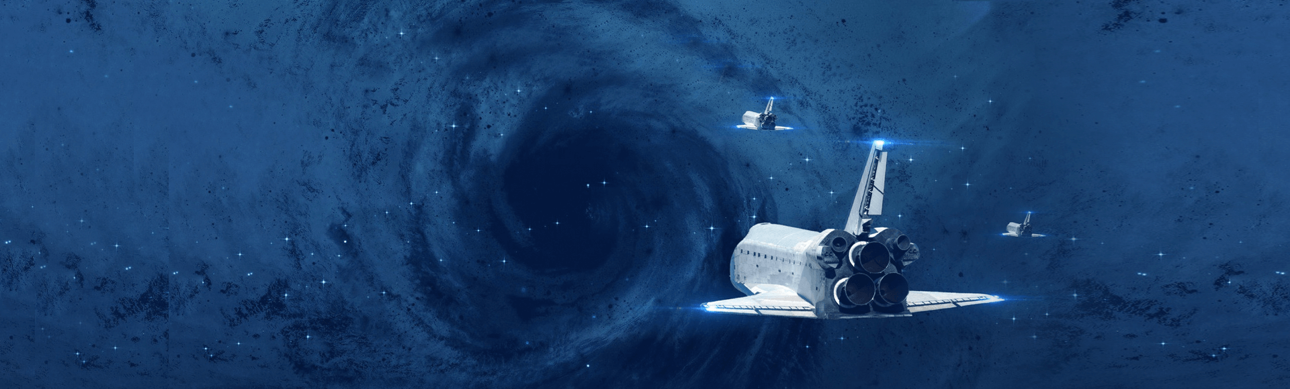
Interstellar – Motivation
Disadvantages of current KGE models
Pure KGE model (based on single triplet)
cannot capture the information among multiple triplets
RNN-based model (based on paths)
while it can capture the long-term information along steps
it will overlook domain-specific properties like the semantics inside each triplet without a customized architecture
GCN-based model (based on (sub)graphs)
do not scale well ﻿since the entire KG needs to be processed and it has large sample complexity
GCN has been theoretically proved to have worse generalization guarantee than RNN in sequence learning tasks
AutoML
﻿Inspired by the success of neural architecture search (NAS)
﻿However, designing the search space for recurrent neural network attracts little attention
﻿the searched architectures mainly focus on cells rather than connections among cells
Interstellar
propose to search recurrent architectures as the Interstellar to learn from the relational path

Slide 11
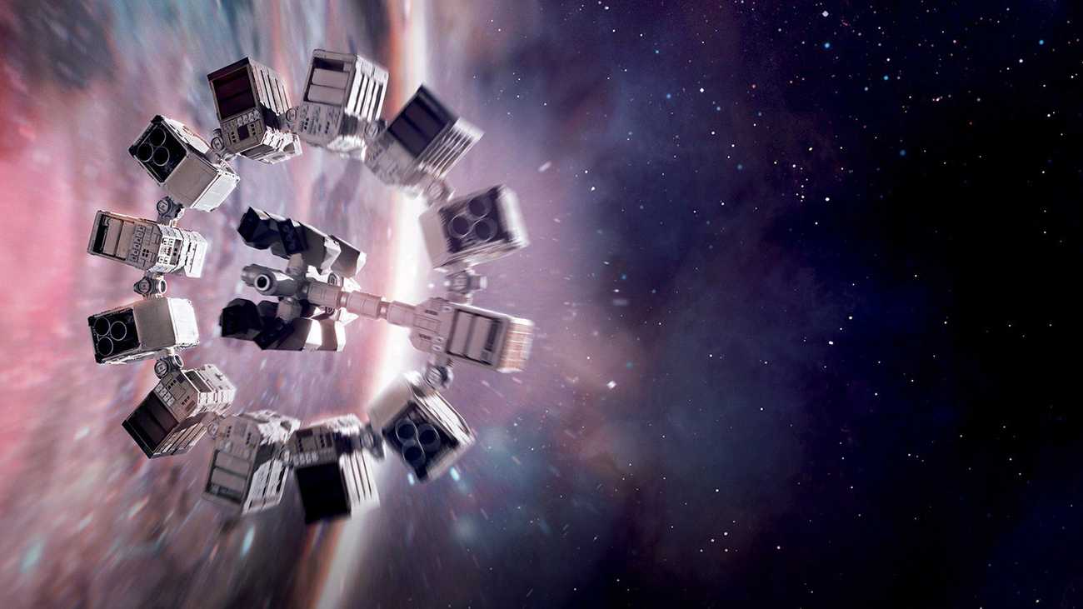

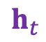

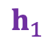
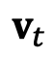
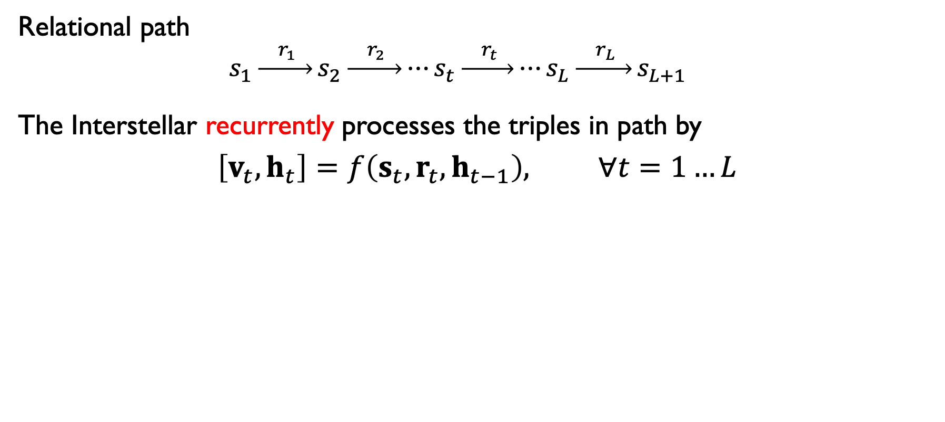
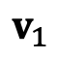




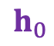


Interstellar – Definition
Relational path
$$s_{1}\underset{→}{{ r}_{1} }s_{2}\underset{→}{{ r}_{2} }⋯s_{t}\underset{→}{{ r}_{t} }⋯s_{L}\underset{→}{{ r}_{L} }s_{L+1}$$
The Interstellar recurrently processes the triples in path by
$$\left[v_{t},h_{t}\right]=f\left(s_{t}, r_{t}, h_{t−1}\right), ∀t=1…L$$
$$v_{1}$$
$$\sim s_{2}$$
$$v_{t}$$
$$\sim s_{t+1}$$
$$h_{1}$$
$$h_{t}$$
$$h_{0}$$
$$⋯$$
$$⋯$$
$$s_{1}$$
$$r_{1}$$
$$s_{t}$$
$$r_{t}$$
How to adaptively model $f\left(⋅\right)$ in different KG scenarios?

Slide 12
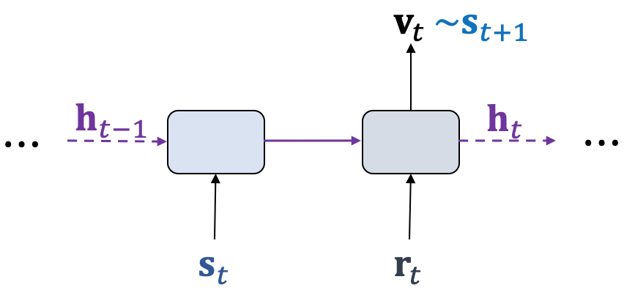
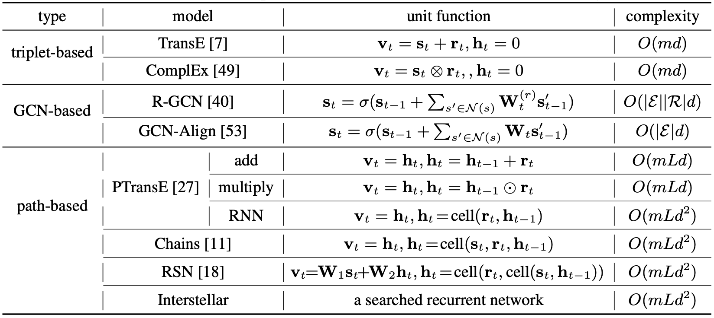
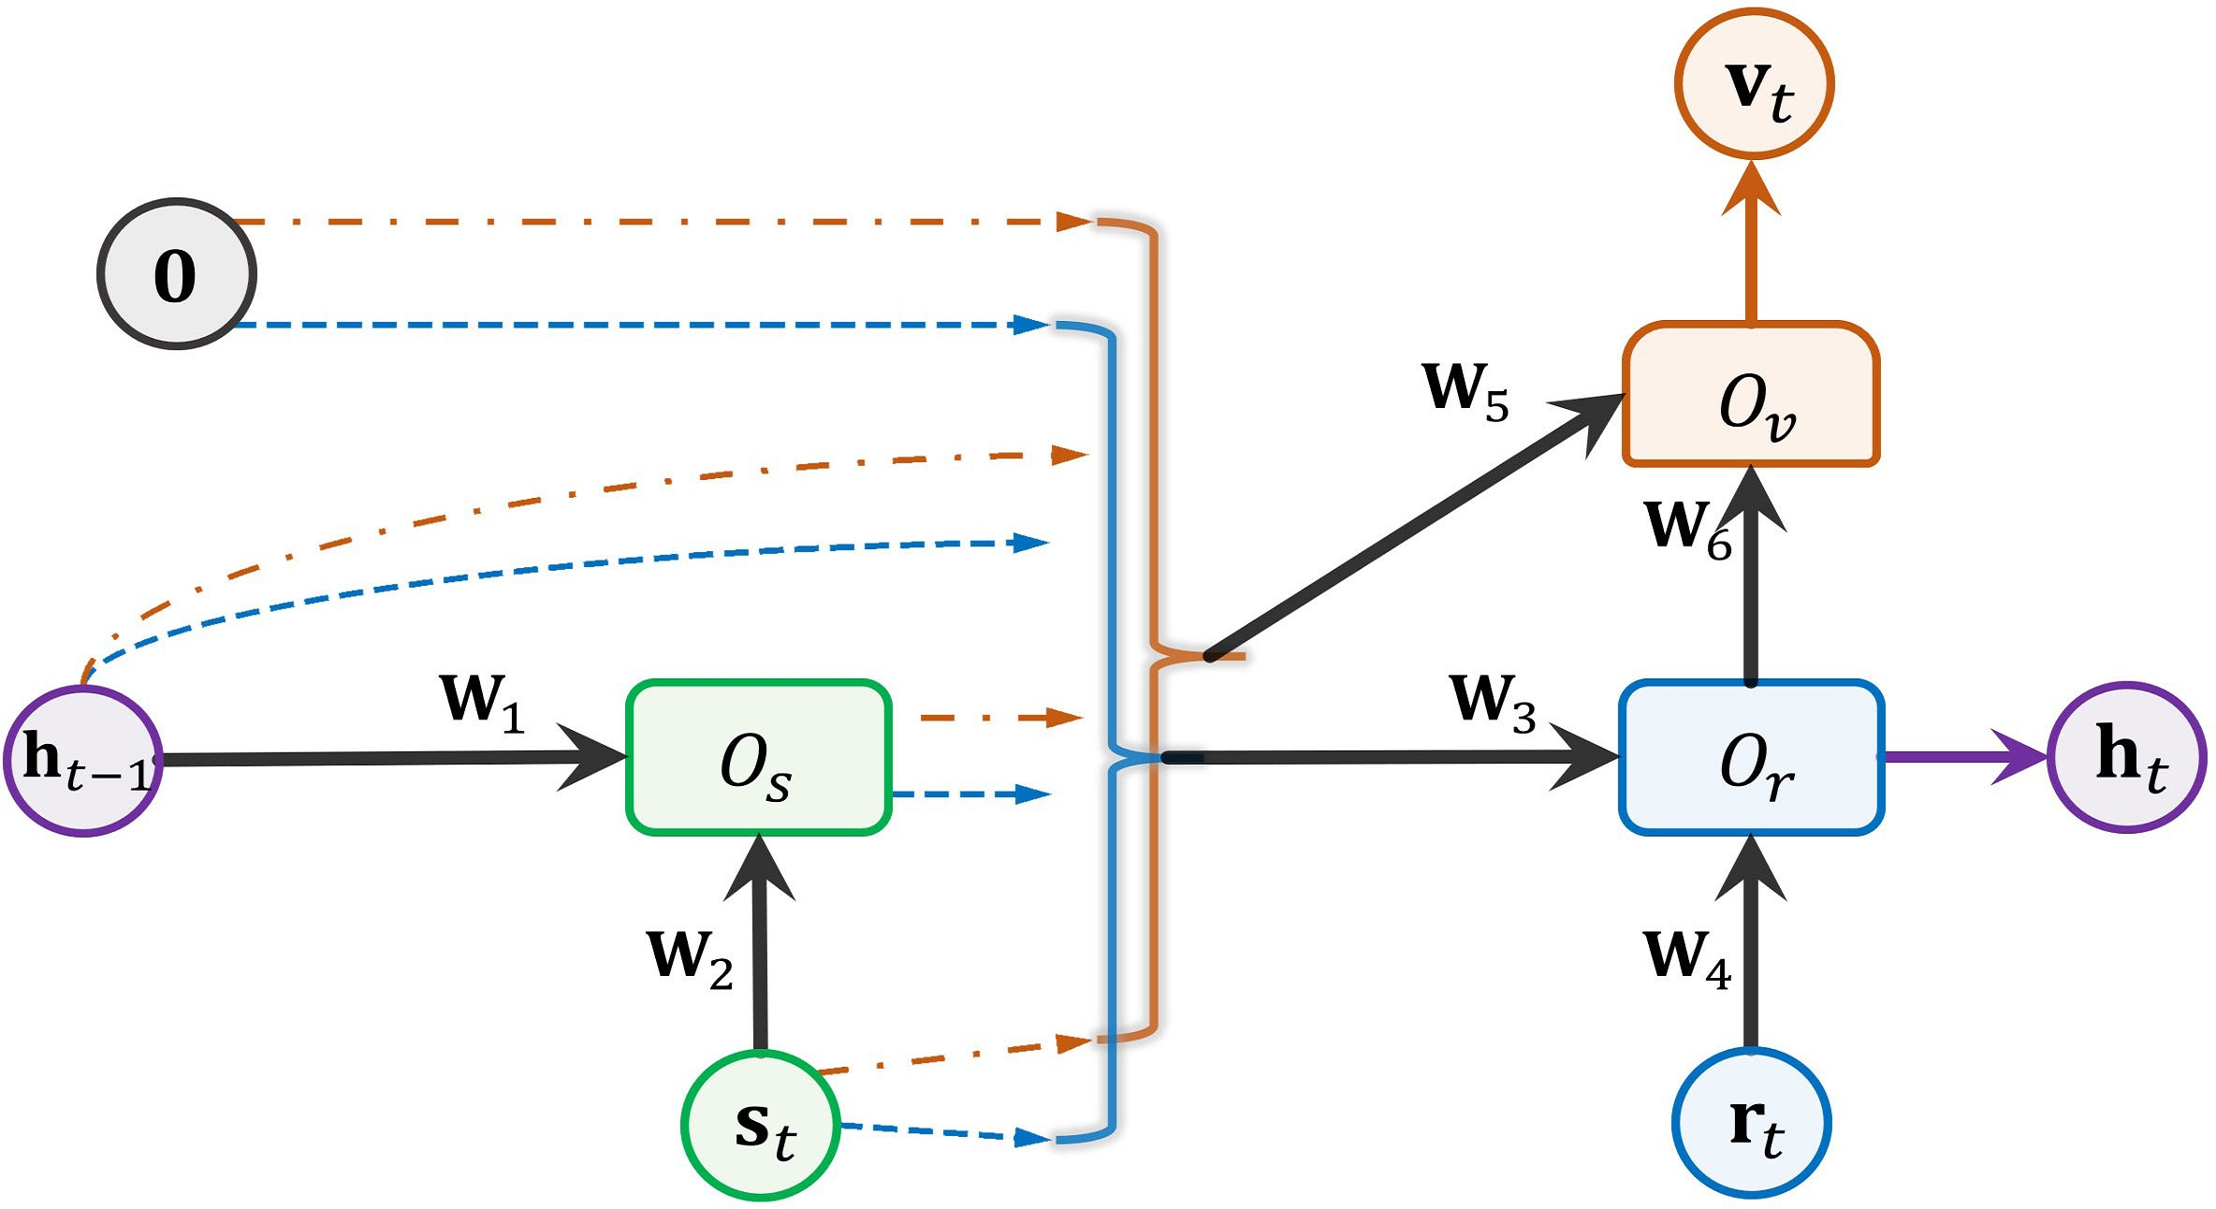
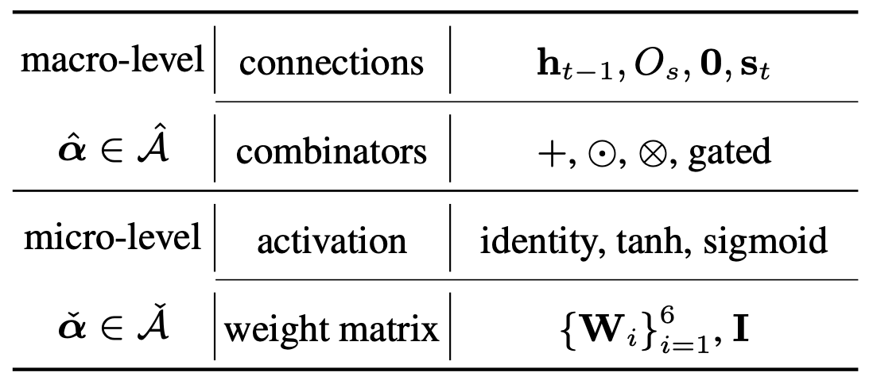
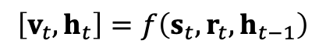
Interstellar – Search Space
﻿Compared with standard RNNs, which recurrently model each input vectors,
the Interstellar models the relational path with triplets as basic unit.
In this way, we can determine how to model short-term information inside each triplet and what long-term information should be passed along the triplets.
$$\left[v_{t},h_{t}\right]=f\left(s_{t}, r_{t}, h_{t−1}\right)$$
search the connections i.e., the dashed lines
Detailed search space

Slide 13
Interstellar – Search Space
Detailed search space
﻿4² × 4³ = 1024
﻿3² × 2⁶ = 576
6×10⁵ candidates in total
﻿How to efficiently search the architectures? 🤔
Bi-level Optimization Problem:
α: model architecture
F﻿: learnable weights
M: measurement on G_{val}
L: loss on G_{tra}

Slide 14
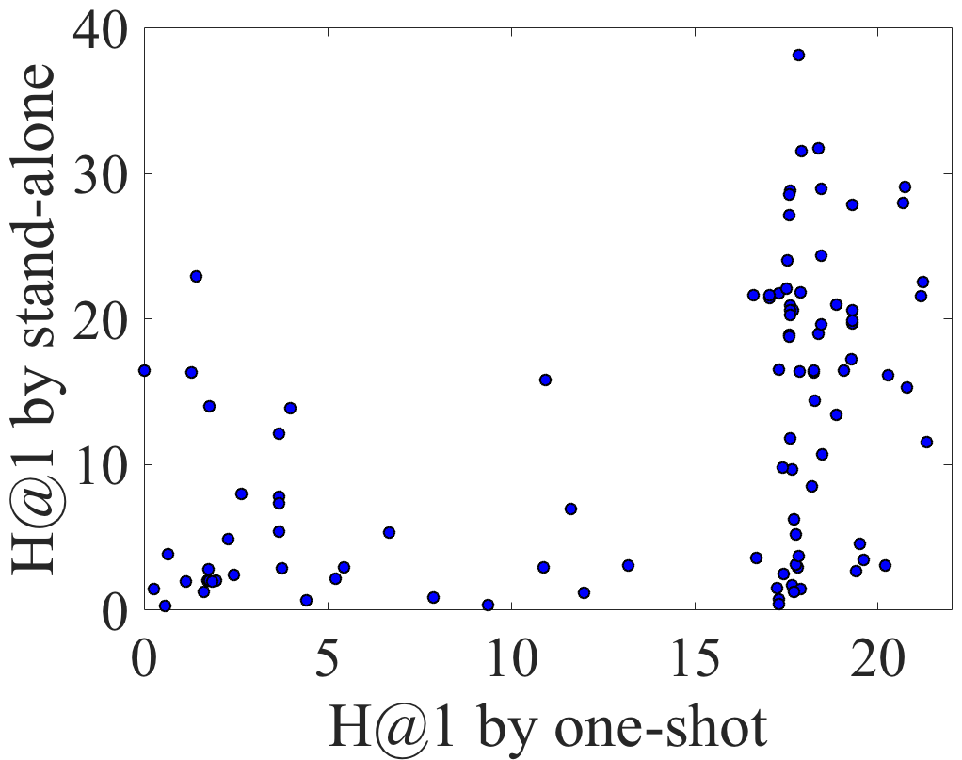

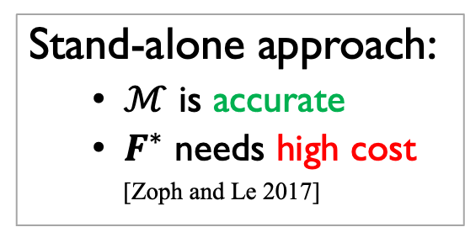
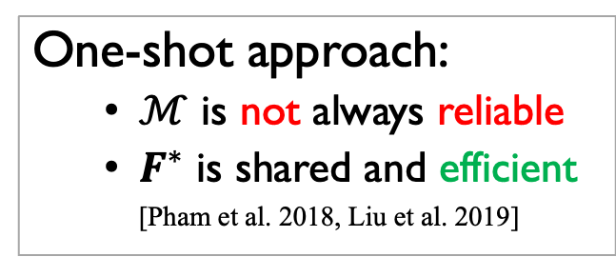
Interstellar – Search Algorithm
How to efficiently search the architectures?
Search appropriate $α∈𝒜$ that maximize the validation performance
Two common
search approaches:
Stand-alone approach:
$ℳ$ is accurate
$F^{∗}$ needs high cost
[Zoph and Le 2017]
One-shot approach:
$ℳ$ is not always reliable
$F^{∗}$ is shared and efficient
[Pham et al. 2018, Liu et al. 2019]
F﻿: learnable weights
M: measurement on G_{val}
Correlation is weak.
Is it possible to take advantage of both?

Slide 15
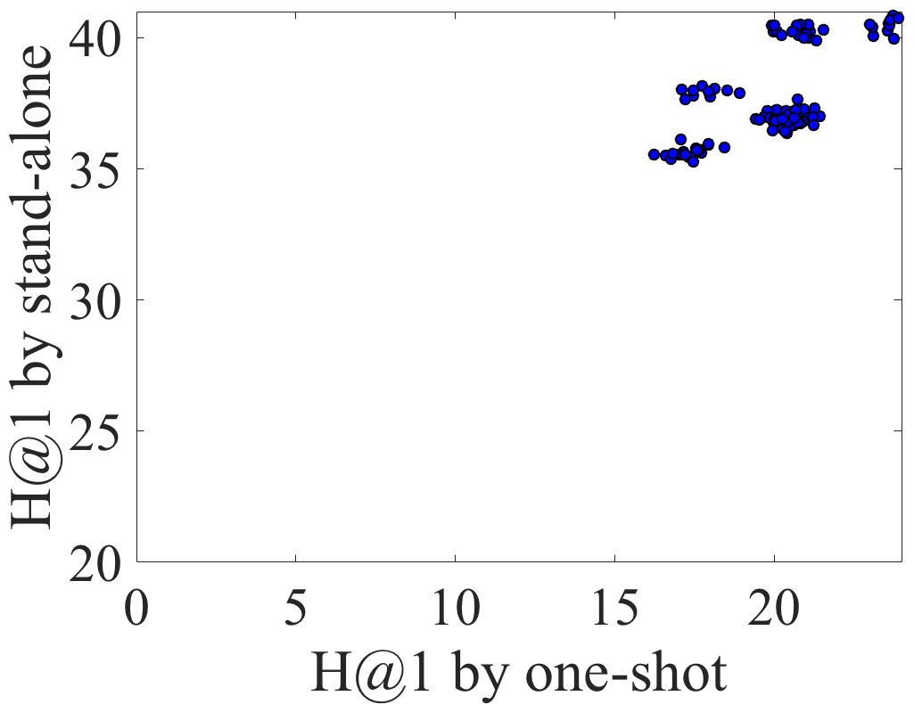
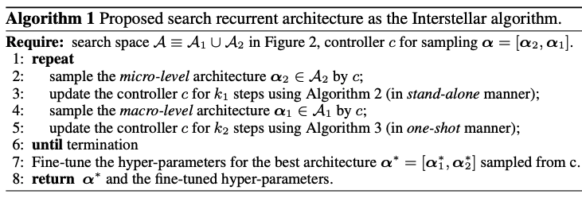

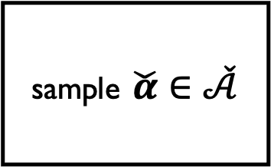
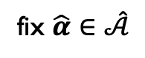
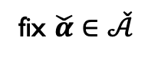

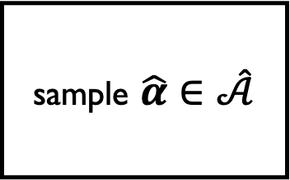
Hybrid search algorithm
Interstellar – Search Algorithm
Correlation is much stronger
update $\hat{k}$ steps in stand-alone manner
Reliable feedback.
micro-level
macro-level
sample $\check{α}∈\check{𝒜}$
sample $\hat{α}∈\hat{𝒜}$
fix $\hat{α}∈\hat{𝒜}$
controller
fix $\check{α}∈\check{𝒜}$
Efficient evaluation.
update $\check{k}$ steps in one-shot manner

Slide 16
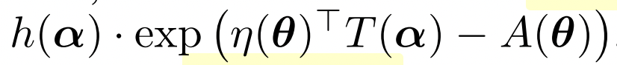
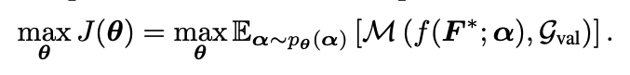
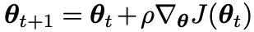
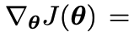
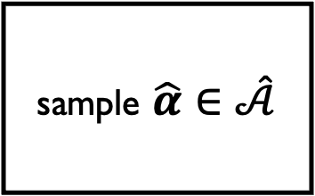
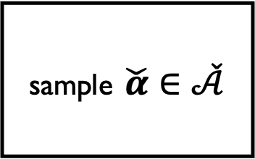
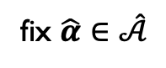
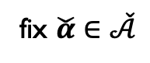
Interstellar – Search Algorithm
update in stand-alone manner
micro-level
macro-level
sample $\check{α}∈\check{𝒜}$
sample $\hat{α}∈\hat{𝒜}$
fix $\hat{α}∈\hat{𝒜}$
controller
fix $\check{α}∈\check{𝒜}$
update in one-shot manner
distribution of exponential family
Using policy gradient to optimize the controller

Slide 17
Outline
Background
Interstellar
Motivation
Method
Experiments
Key takeaways and research directions

Slide 18
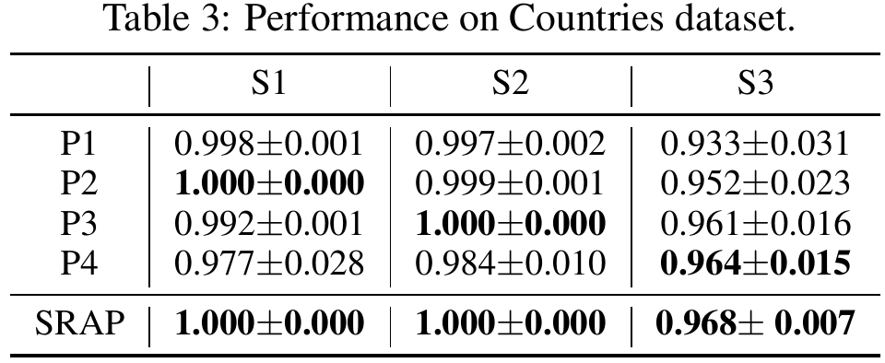

Interstellar – Experiments
P1: single triplet
P2: two triples
P3: relation composition
P4: fully recurrent
data | tasks
S1 | neighbor$∧$ locatedin $→$ locatedin locatedin$∧\text{locatedin} → \text{locatedin}$
S2 | neighbor$∧$ locatedin $→$ locatedin
S3 | neighbor$∧$ locatedin $∧$ locatedin $→$ locatedin
harder
longer
Interstellar
Example
train: Serbia, neighbor, croatia
train: Serbia, locatedin, southern_europe
test: Serbia, locatedin, europe
Model design should be task dependent 🤔

Slide 19


Interstellar – Link prediction task
Link prediction
SimplE/CP [2018]
Interstellar [2020]
RotatE [2019]
ConvE [2018]
ComplEx [2017]
RSN [2019]
DistMult [2015]
RESCAL [2011]
TransE [2011]
PTransE [2015]
complexity
Searched models:
Existing models:
WN18RR
FB15k-237

Slide 20


Interstellar – Entity alignment task
Entity alignment
Interstellar [2020]
Chains [2016]
RSN [2019]
IPTransE [2017]
TransD [2014]
PTransE [2015]
TransE [2011]
complexity

Slide 21



Interstellar – Efficiency
entity alignment
link prediction

Slide 22
Outline
Background
Interstellar
Motivation
Method
Experiments
Key takeaways and research directions

Slide 23
Key takeaways and Research directions
﻿Interstellar analyzes the difficulty and importance of using the relational path to learn the short-term and long-term information in KG.
Interstellar formulates the KGE task as a NAS problem and propose a domain-specific search space. Different from searching RNN cells, the recurrent network is specifically designed for KG tasks.
This is the first work applying neural architecture search (NAS) methods on KG tasks.
Interstellar identifies the problems of adopting stand-alone and one-shot search algorithms for our search space, and designs a hybrid-search algorithm to search efficiently.
Contributions of Interstellar:
Analyze the difficult and importance of learning from relational path
Setup problem by NAS
Novel search space
Hybrid search algorithm

Slide 24
Key takeaways and Research directions
Towards Automated Knowledge Graph Embedding
Analyze problems
high requirements of human intelligence
e.g., model design & training & fine-tuning
model performance is data-dependent
Summary of existing models → General search space “拆解”
cover existing models
References of existing search algorithms → Improved algorithm “组装”
efficient and accurate evaluation
Combine the search space and algorithm → Better performance/adaptivity
trade off between exploration and exploitation

Slide 25



Key takeaways and Research directions
General effectiveness and efficiency evaluation results
No best models 🤔

Slide 26



Key takeaways and Research directions
Future research directions
Conduct experiments on large-scale datasets
Open Graph Benchmark
Model architecture design
Leverage structural information such as path or subgraph
Capture transferability among datasets and models
Benchmarking the KGE models
Insightful way to analyze model performance
Standard approach to evaluate the different models
Efficient hyper-parameter optimization method
Involving more KG tasks

Slide 27
Q&A
Thanks for your attention!

Slide 28


Appendix

Slide 29

Appendix
﻿long-term information is important for the entity alignment task
while short-term information is important for link prediction task.

Slide 30

Appendix
Calculation of policy gradient

Slide 31


Appendix
AutoSF + Interstellar
Logic rule (e.g. DRUM) + Interstellar
Subgraph processor for KG

Slide 32


Appendix
CNN
Search space:
Search algorithm
Random, Reinforce, Bayes, Gradient-descent, etc
Evaluation method
Stand-alone: train and evaluate separately
One-shot: supernet with parameter-sharing
RNN
…
[Pham et. al. 2018]

